Slide 1

Solar power regression project

Slide 2
PROJECT TEAM GROUP 3
Mentors
Karthik Muskula
Bapuram Pallavi
Team members
Prapanj KM
Sowmini S
Bandaru Bharath Kumar
Saranya Prasad L
Deepa B
Gaurav Moreshwar Gondane
Mihir Atul Humnabadkar

Slide 3
INDEX
Project objective and dataset
Variable description
Exploratory data analysis
Histograms, Boxplots and Scatter plots
Bar charts and Density plots
Skewness and Kurtosis
Heatmap
Outlier detection
Scaling
Model building : Linear, Lasso, Ridge, Decision Tree, Random Forest, ADA Boost, XG Boost and SVR
Model evaluation
Model Performance and Evaluation Parameter matrix
Final Insights and Observations
Deployment Interface
Challenges and Solutions

Slide 4
Project objective and dataset
The variable to be predicted is continuous energy production.
The primary goal is to model energy production as a function of environmental variables using regression.
The dataset solarpowergeneration.csv has been provided for the project.
It contains 10 variables and 2920 rows.

Slide 5
Variable description
Sr. No | Variable | Units
1 | distance_to_solar_moon | radians
2 | temperature | Degrees Celcius
3 | Wind_direction | Degrees (0-360)
4 | Wind_speed | Meters per second
5 | Sky_cover | Scale from 0 to 4
6 | Visibility | kilometers
7 | Humidity | percentage
8 | Average_wind_speed | Meters per second
9 | Average_pressure | Mercury inches
10 | Power_generated | Jules

Slide 6
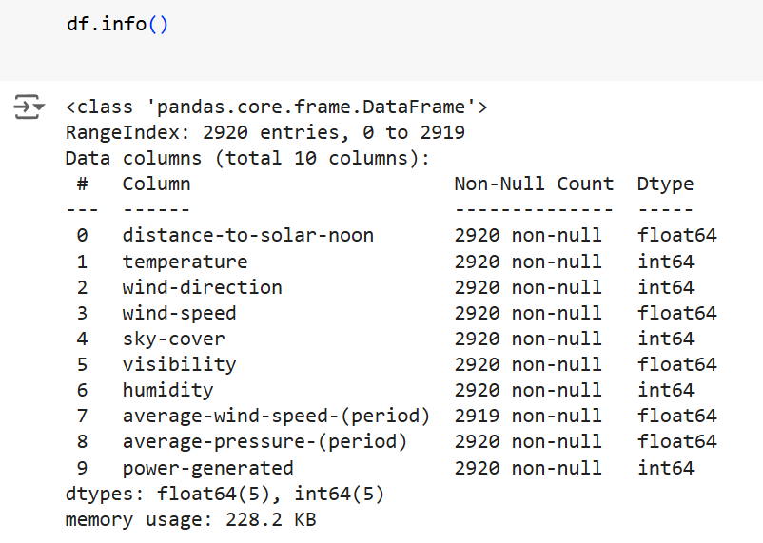
Exploratory data analysis
EDA has been done using pandas, numpy, seaborn and matplotlib.

Slide 7
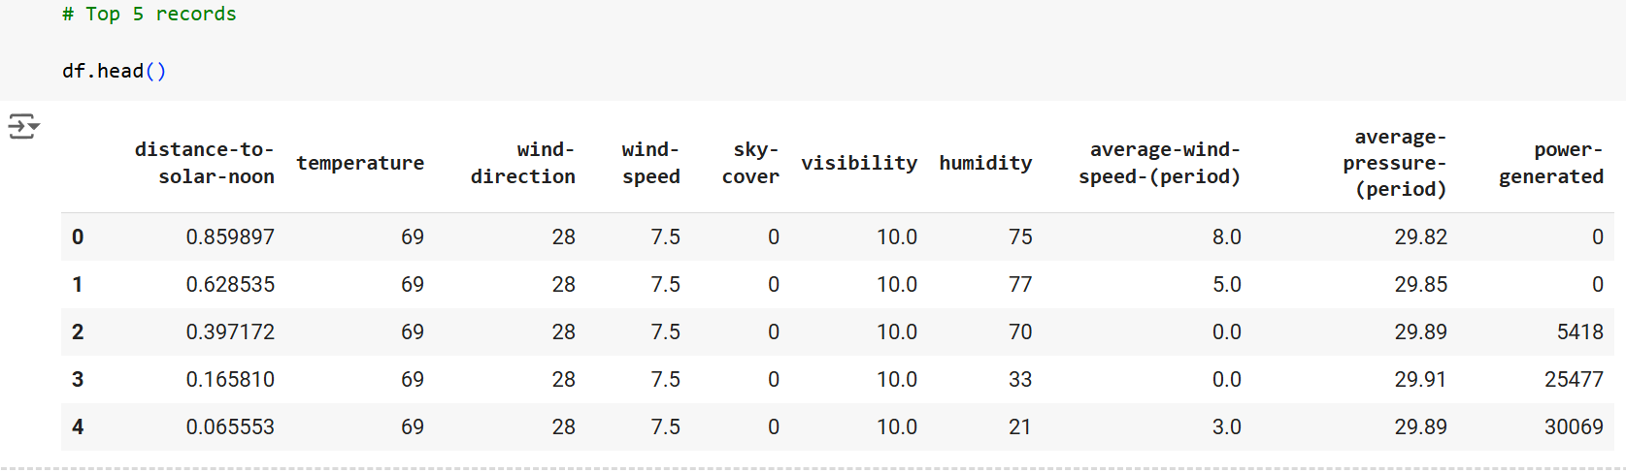
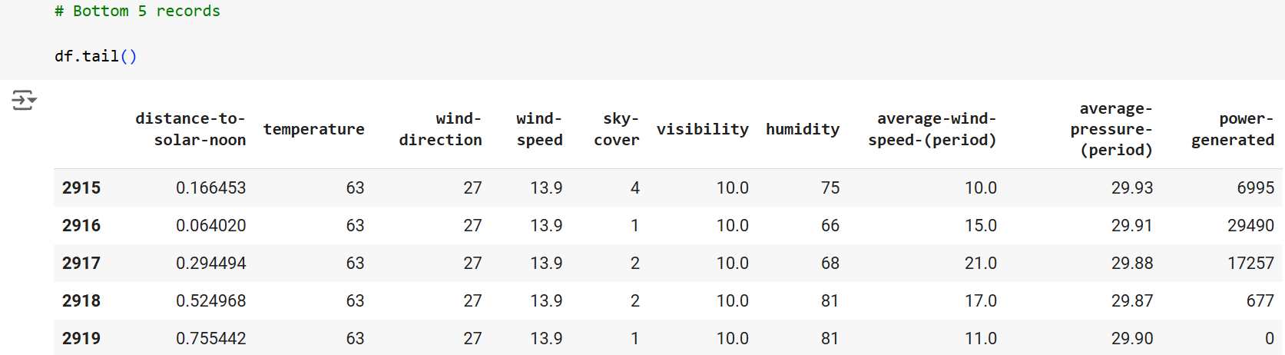
Exploratory data analysis

Slide 8
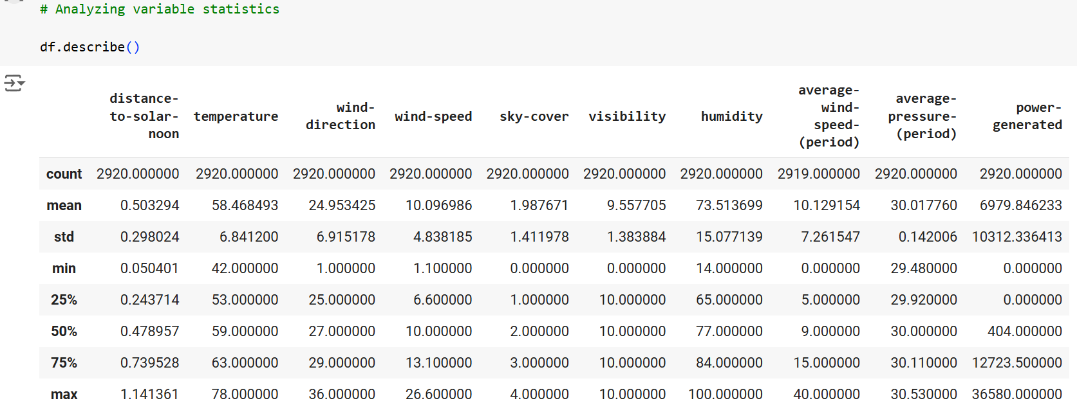
Exploratory data analysis

Slide 9
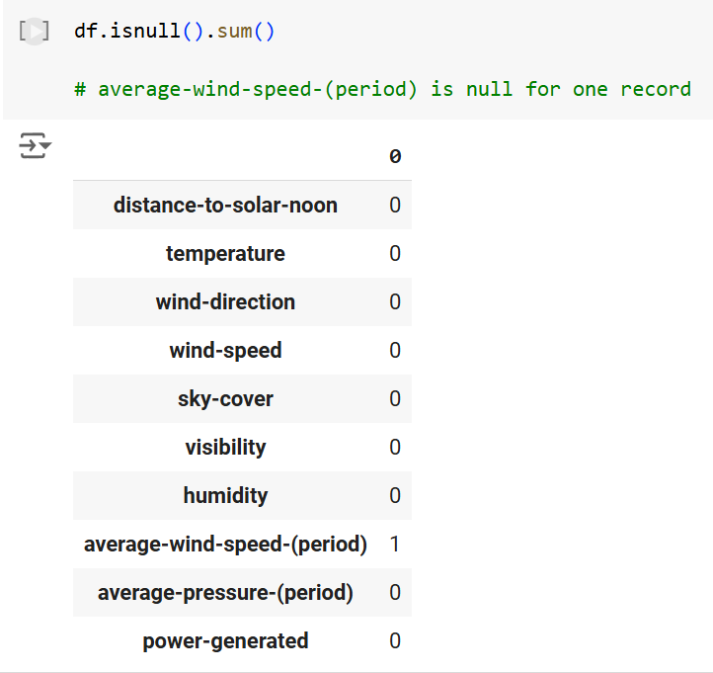
Exploratory data analysis

Slide 10
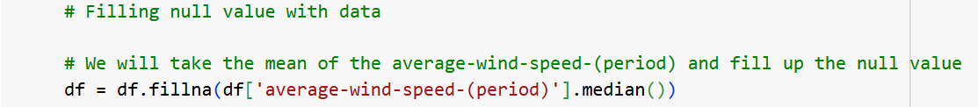
Exploratory data analysis
The empty value has been filled with median of that column
There are no categorical variables in the dataset so one hot encoding or label encoding has not been done.

Slide 11
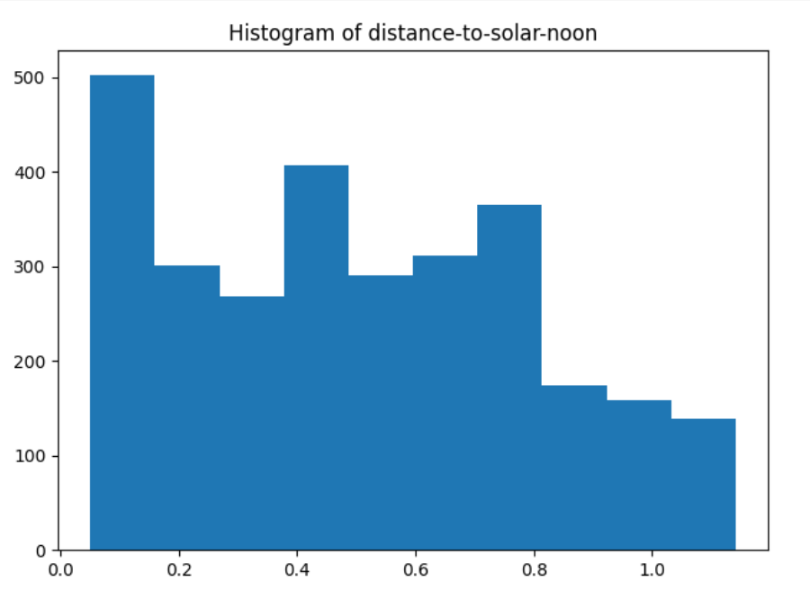
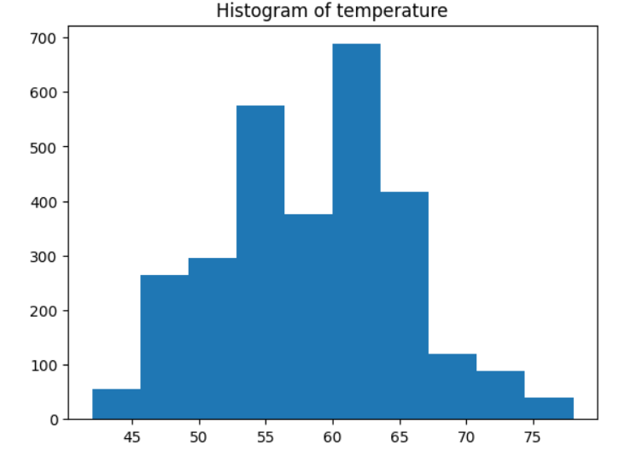
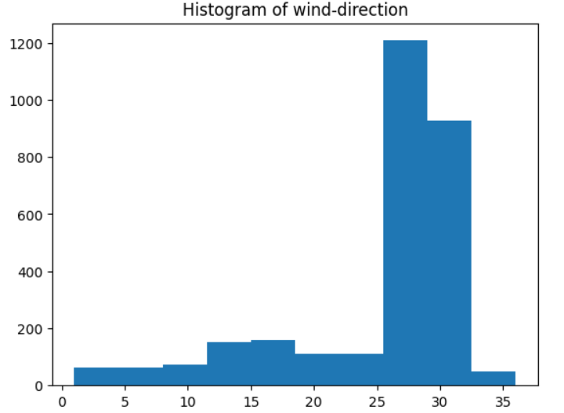
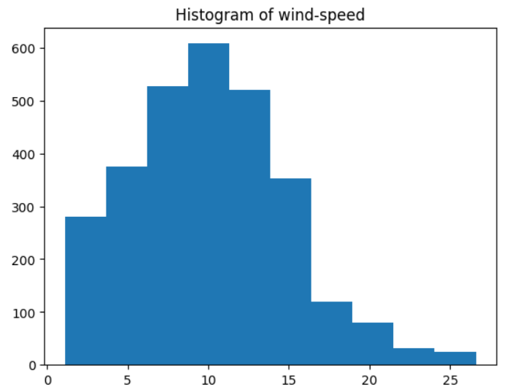
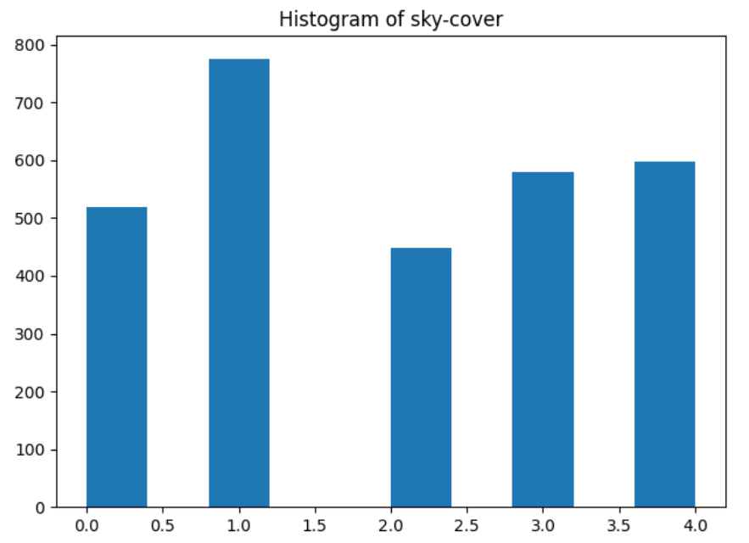
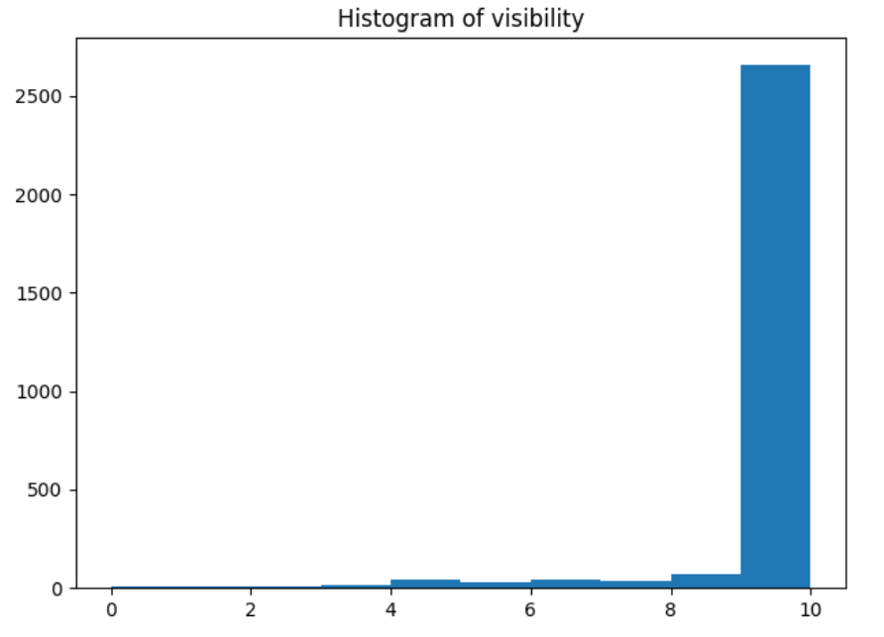
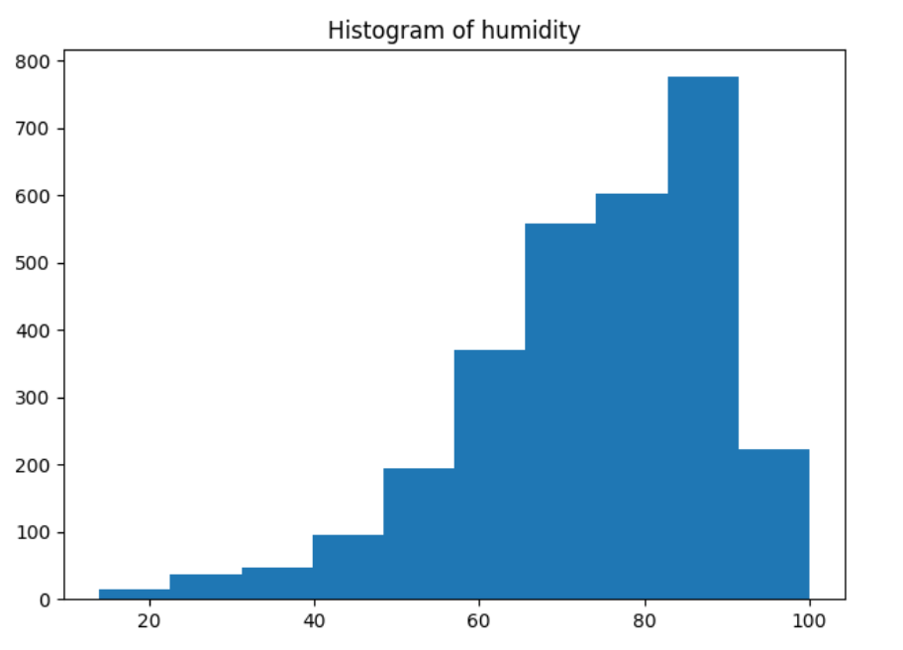
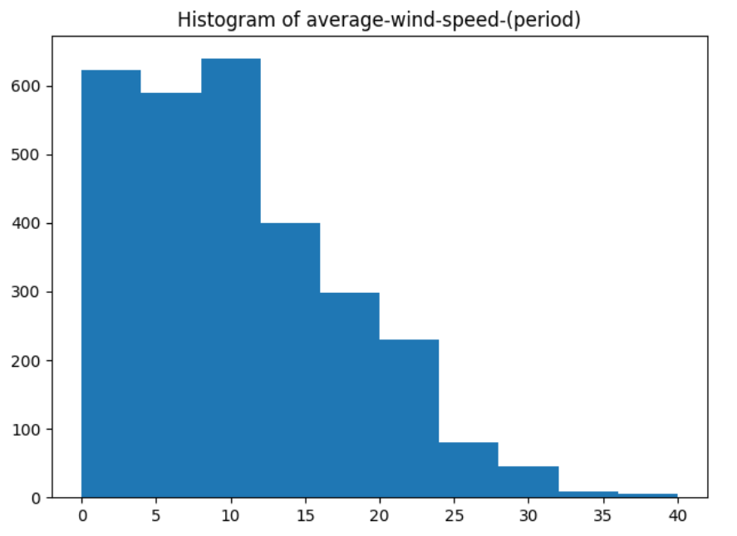
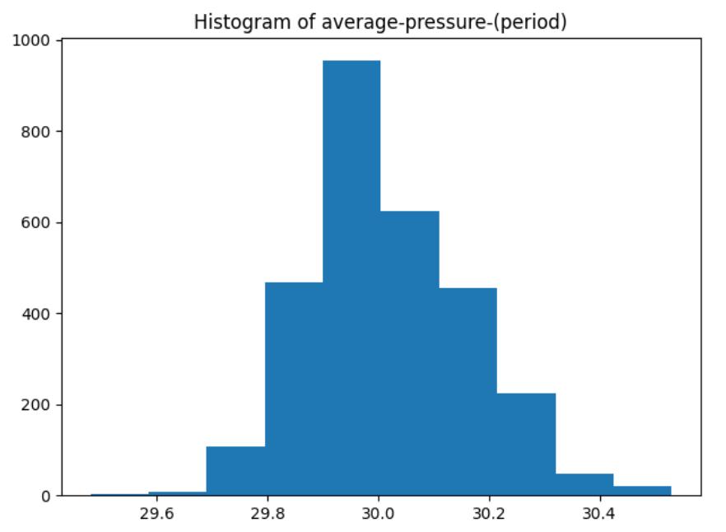
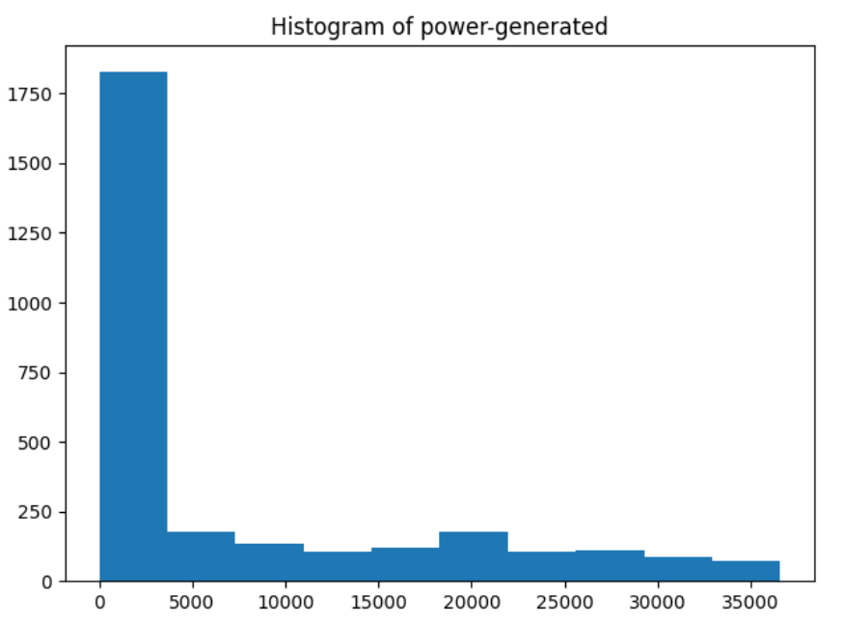
histograms

Slide 12
Histogram insights
Distance-to –solar-noon, temperature, sky-cover and average pressure period have a normal distribution of data.
Wind-direction, visibility and humidity are left-skewed.
Wind-speed period and power generated are right-skewed.
Wind-speed is having a kind of normal distribution but slightly right-skewed.

Slide 13
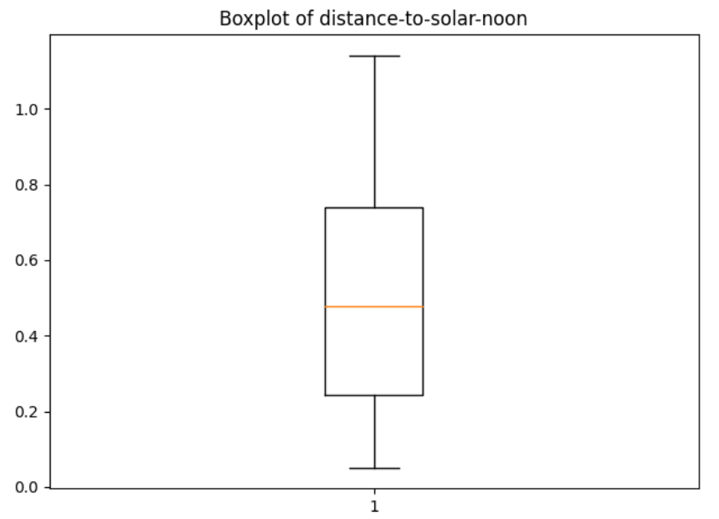
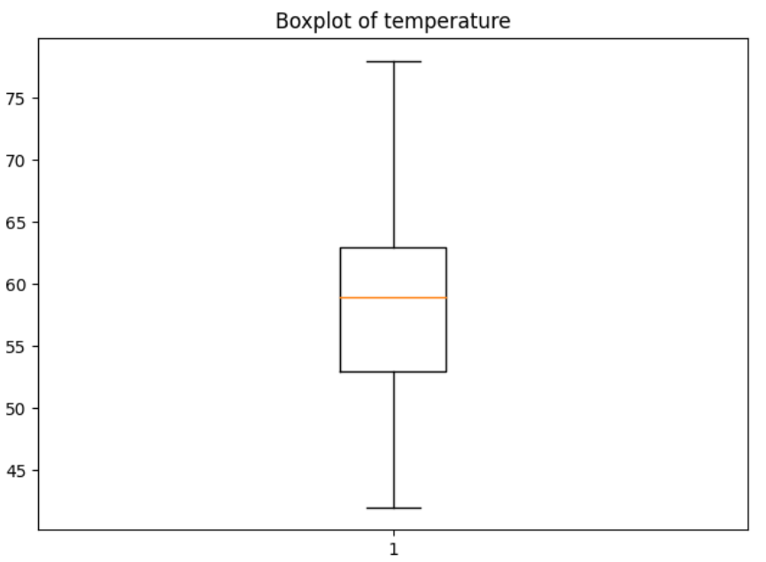
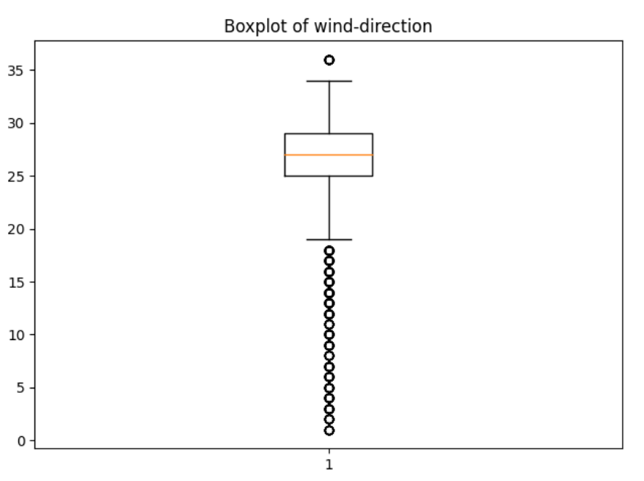
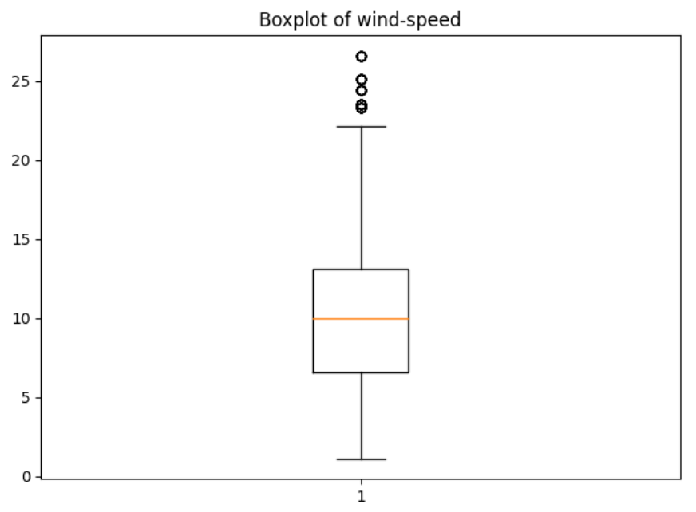
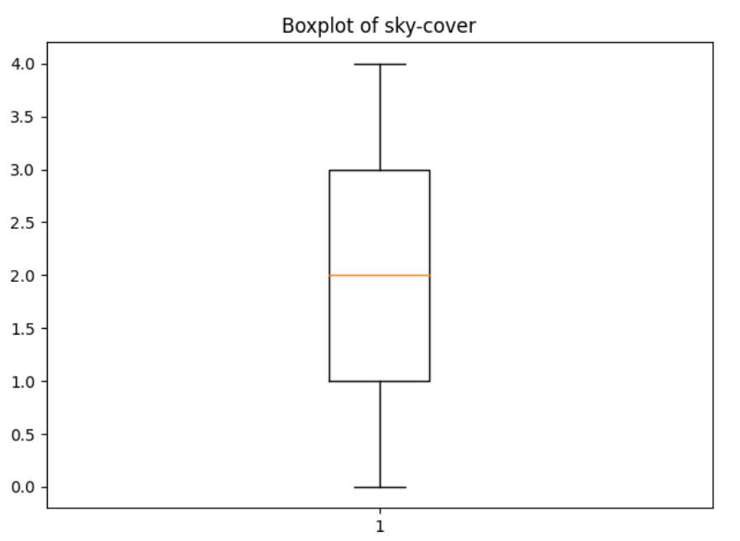
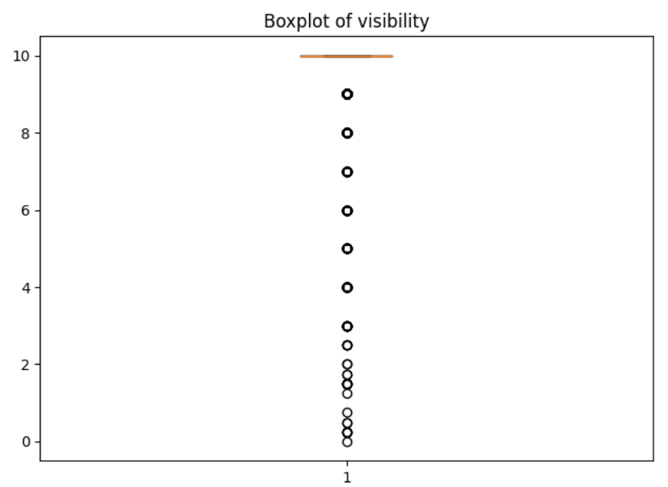
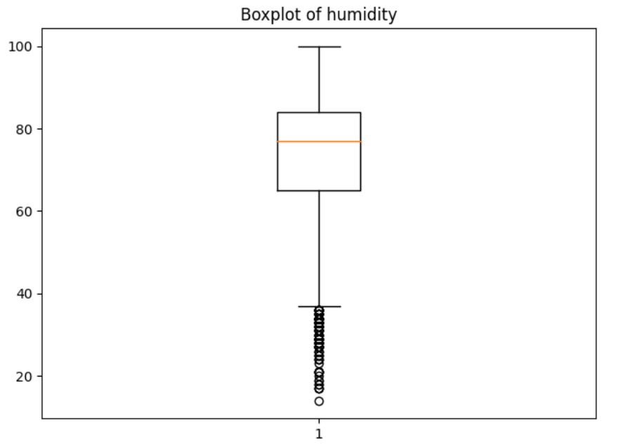
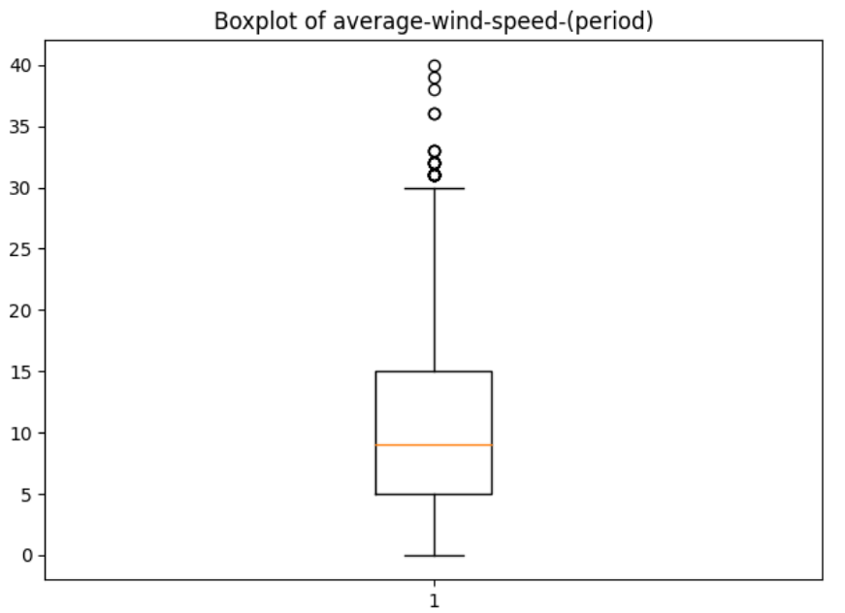
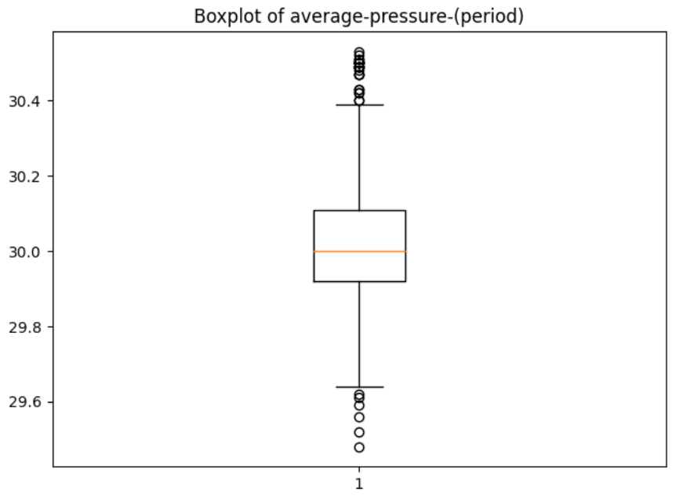
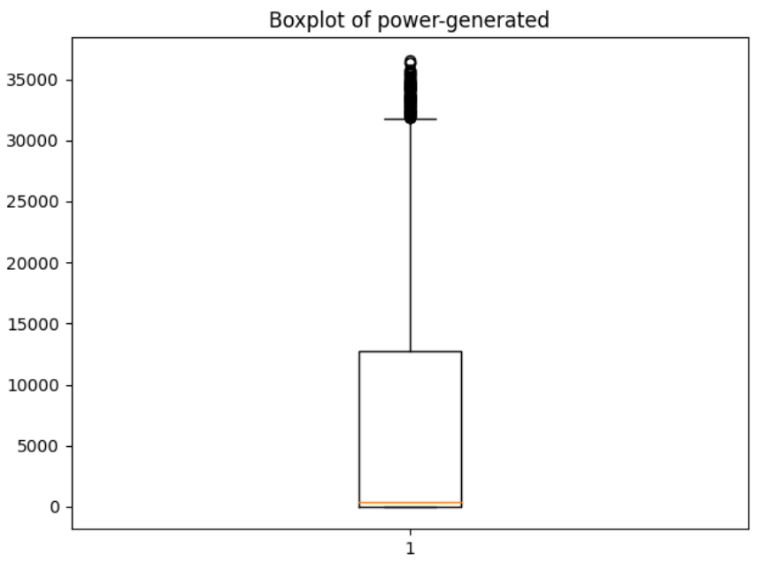
BOX PLOTS

Slide 14
BOX PLOTS insights
Distance-to-solar-noon, temperature and sky-cover have no outliers.
Wind-speed, average wind-speed-period, humidity and average-pressure-period have outliers but in reasonable level.
Wind direction and visibility have a lot of outliers.

Slide 15
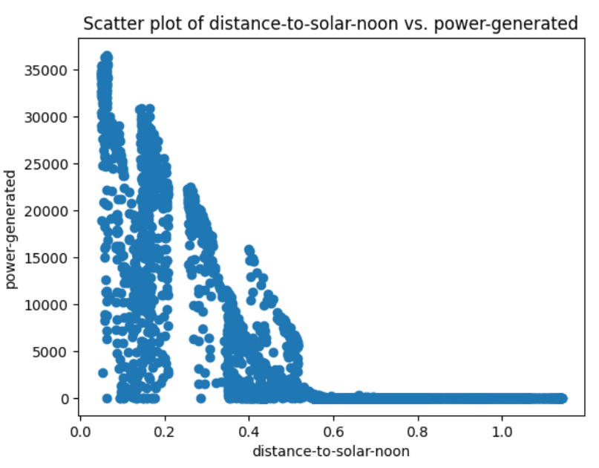
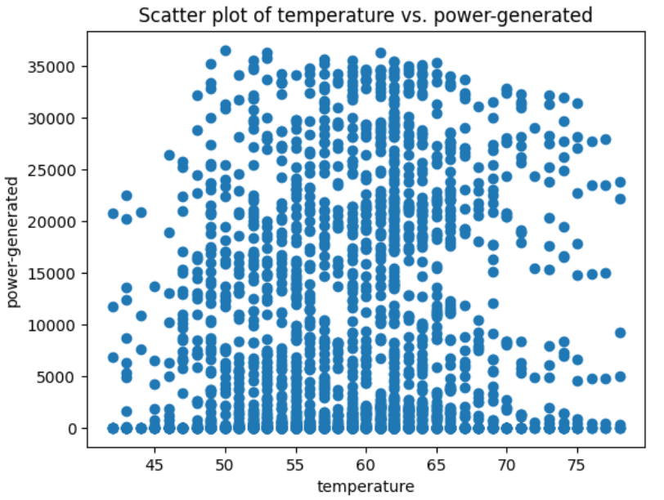
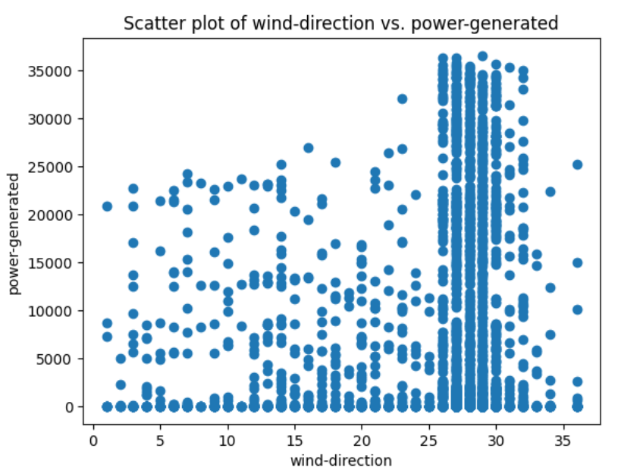
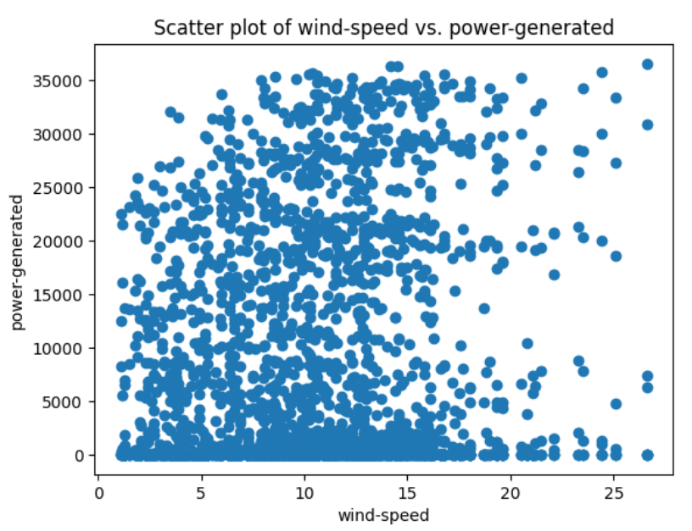
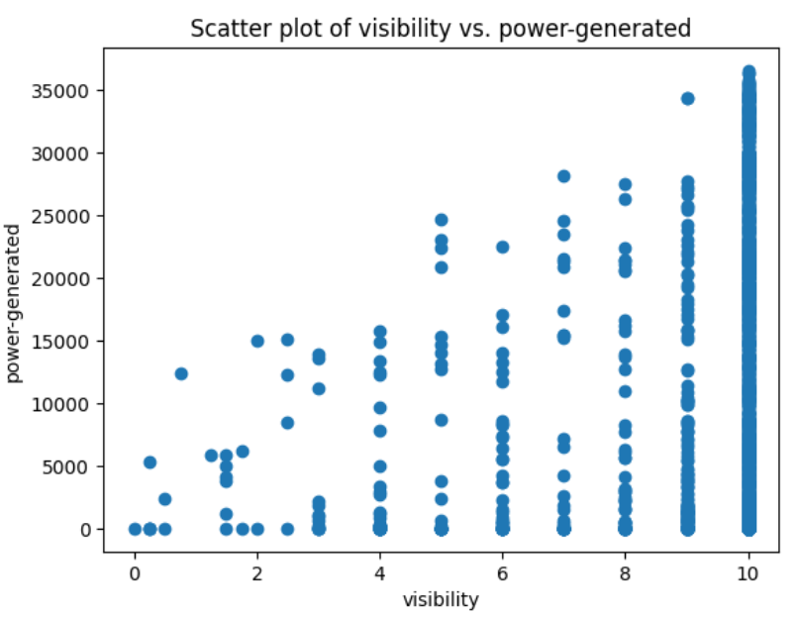
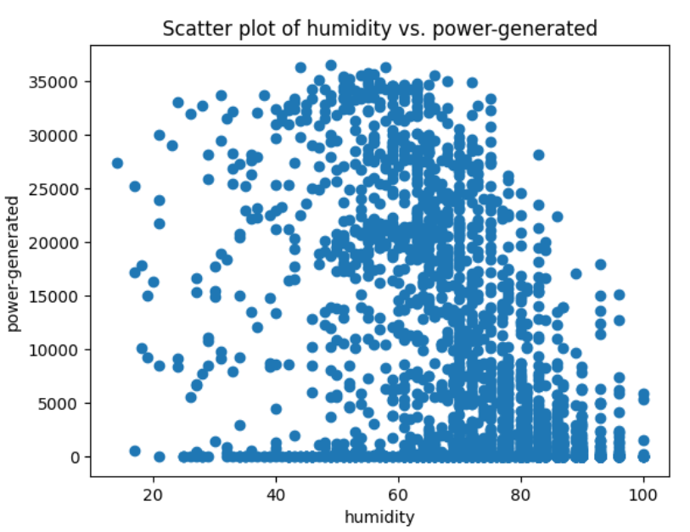
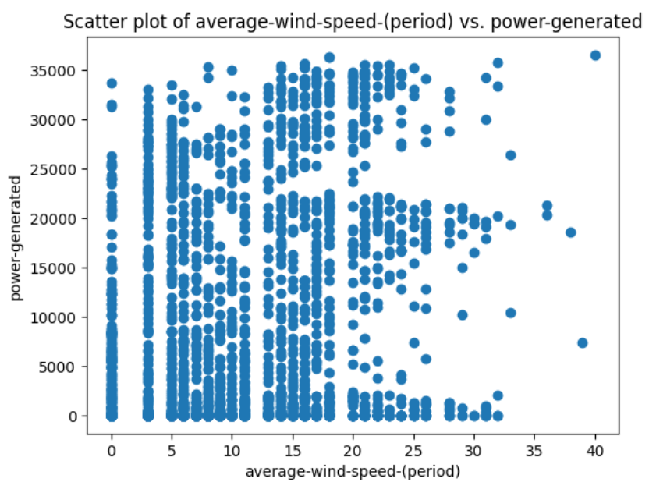
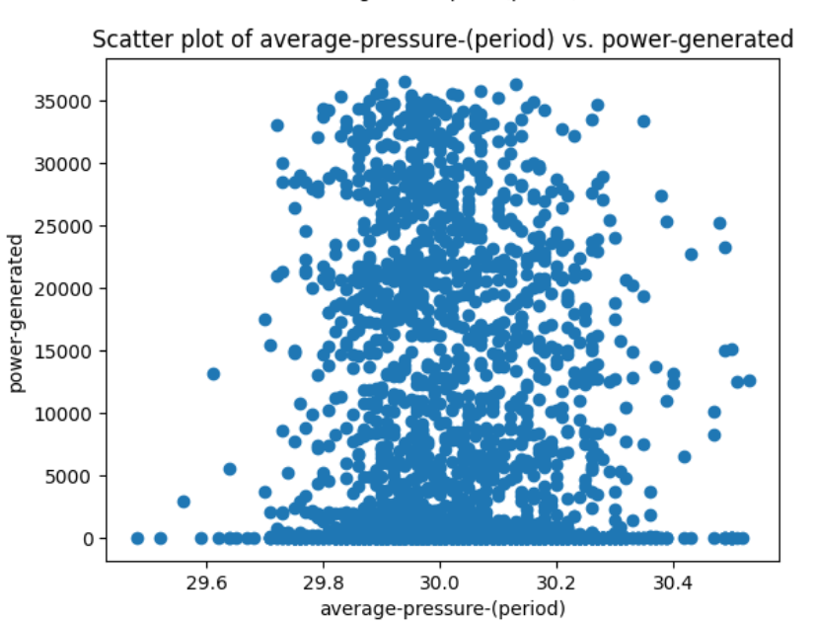
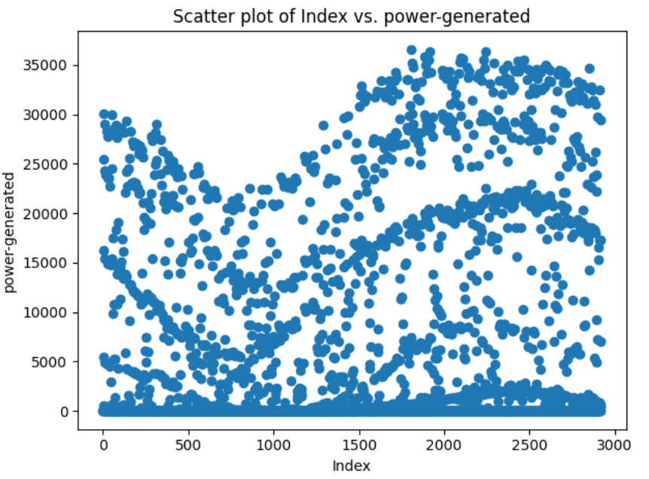
scatter PLOTS

Slide 16
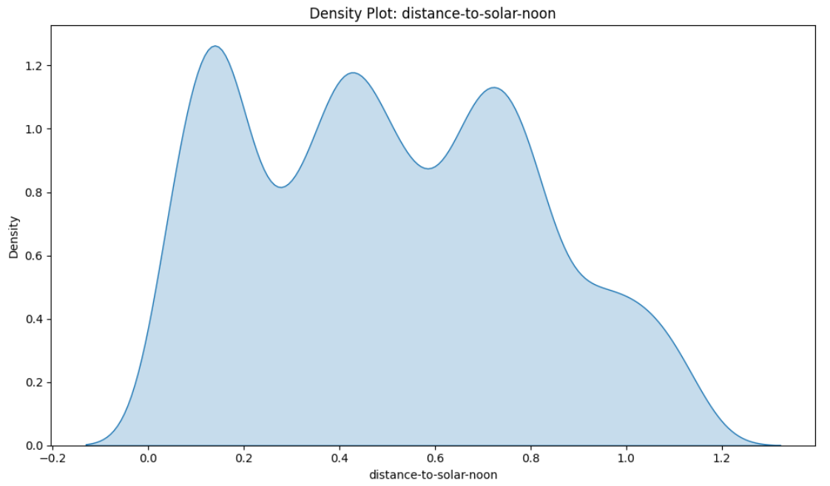
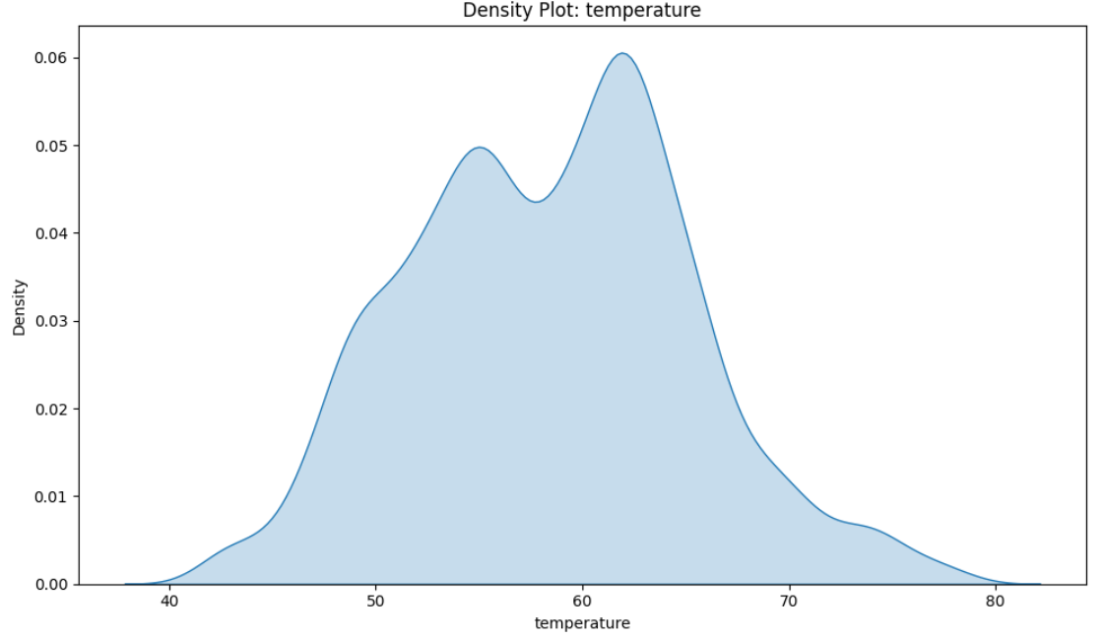
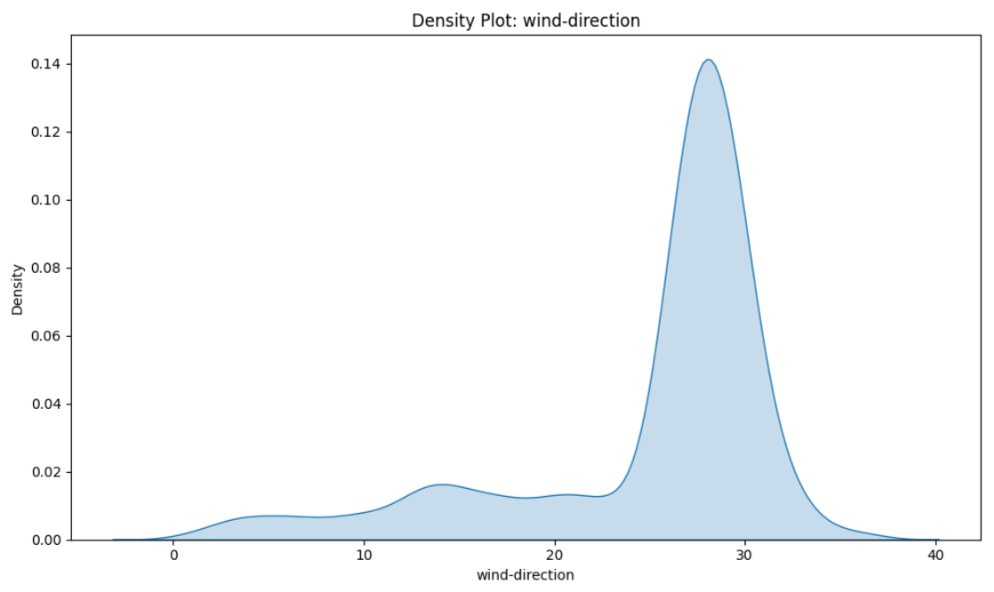
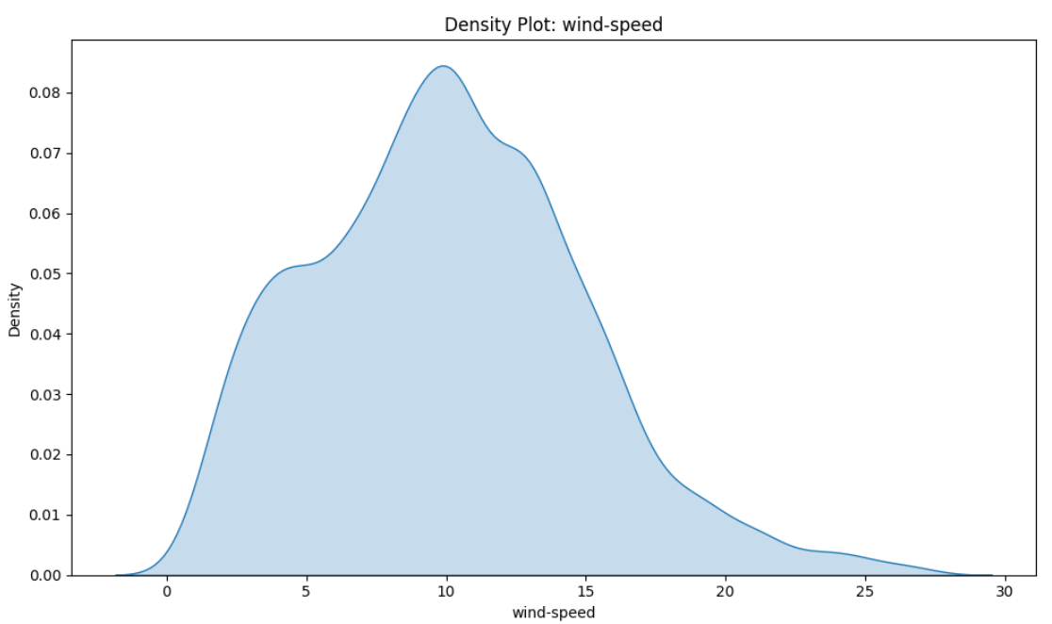
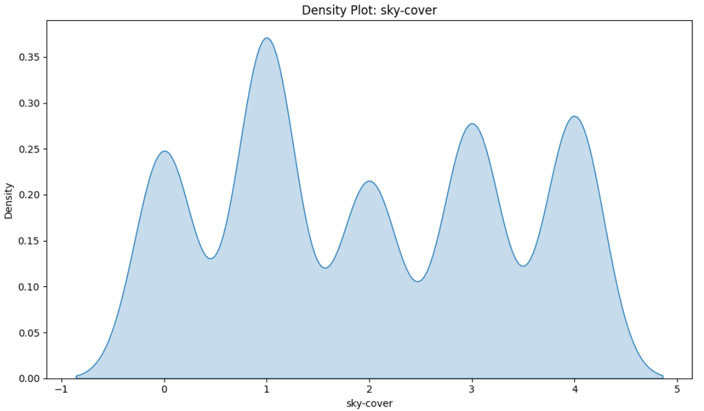
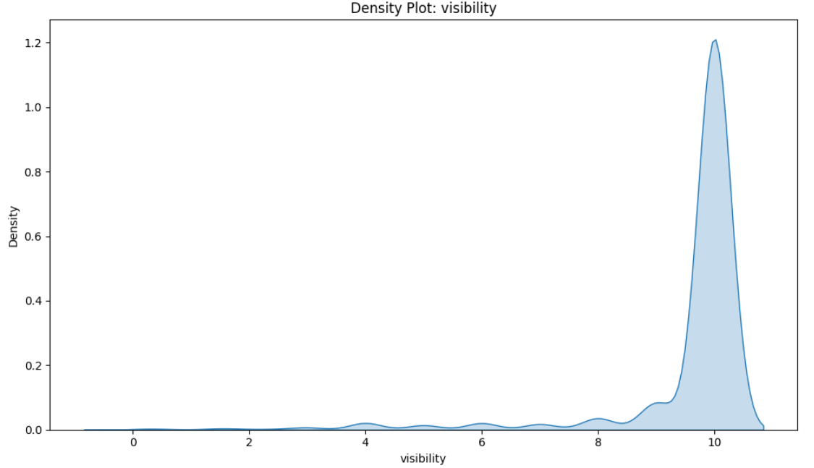
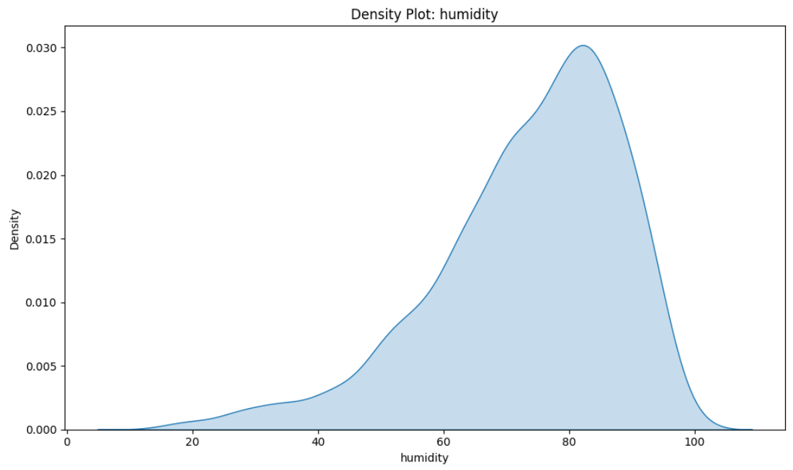
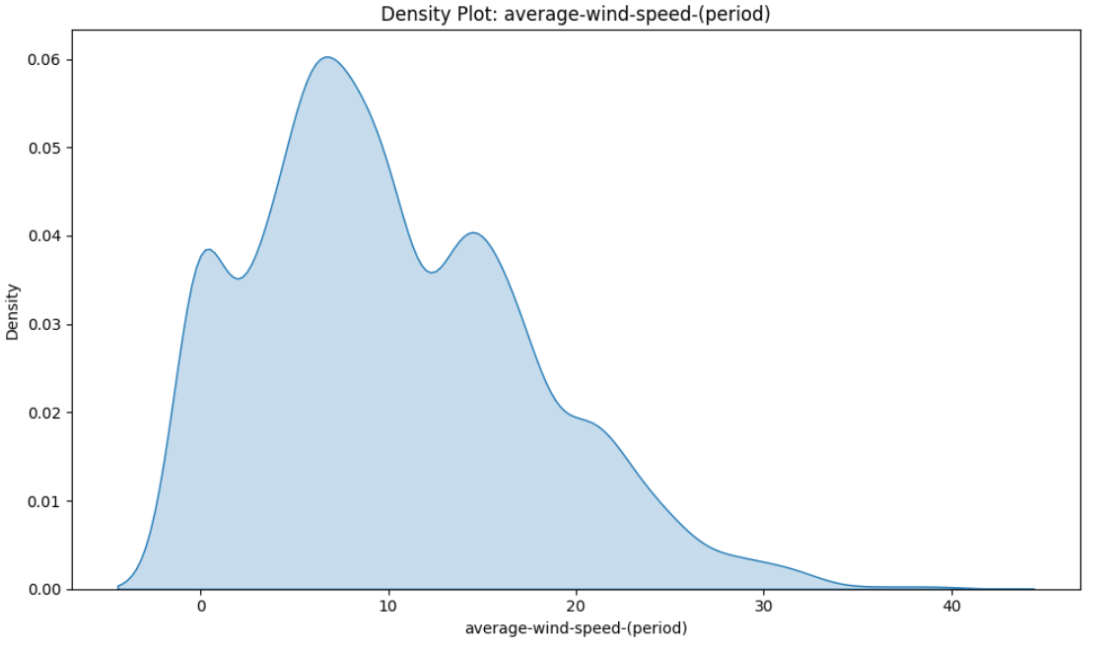
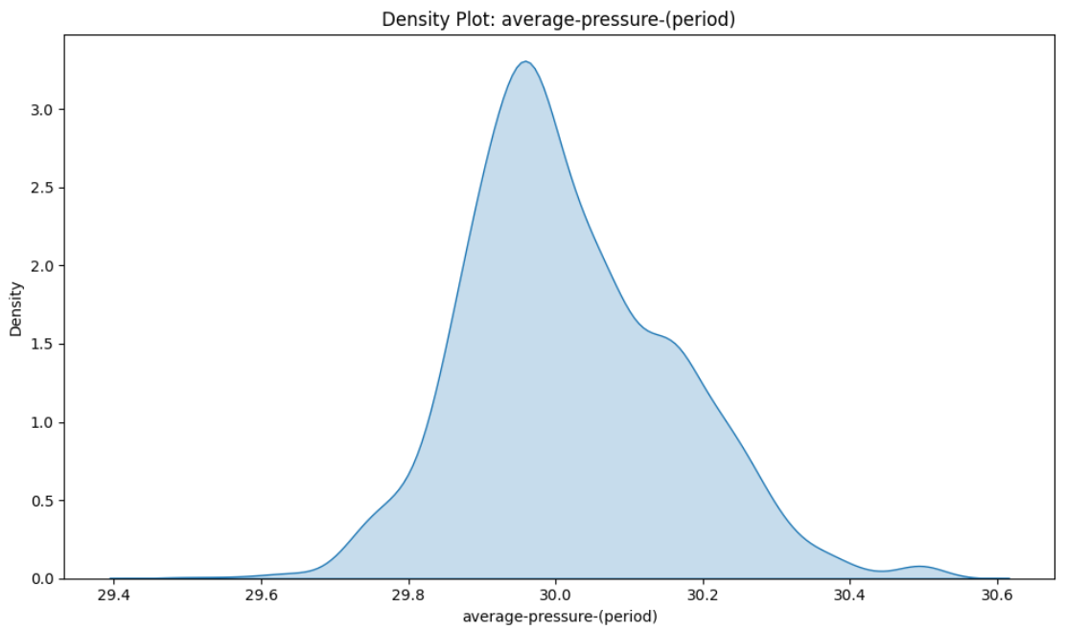
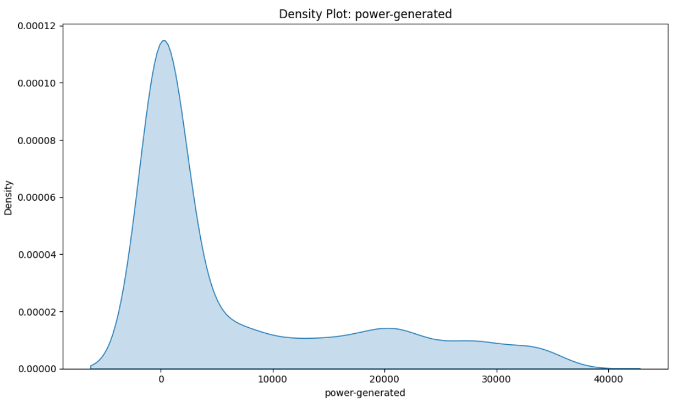
Density plots

Slide 17
Density plots insights
Distance-to–solar-noon, temperature, sky-cover and average pressure period have a normal distribution of data.
Wind-direction, visibility and humidity are left-skewed.
Wind-speed period and power generated are right-skewed.
Wind-speed is having a kind of normal distribution but slightly right-skewed.

Slide 18
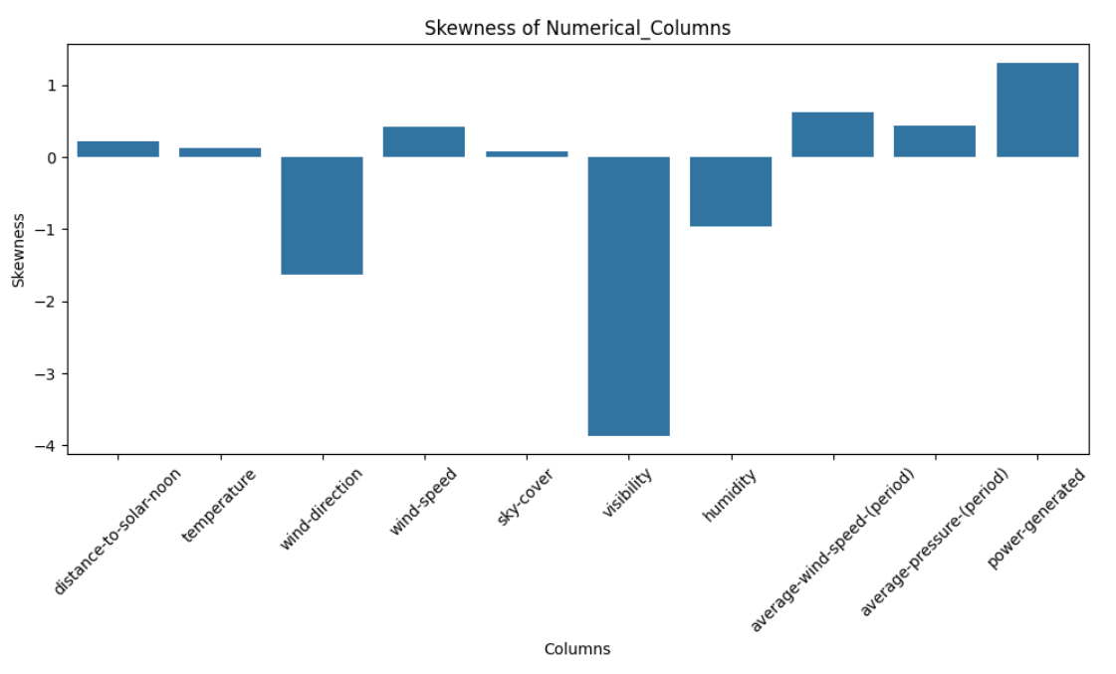
skewness

Slide 19
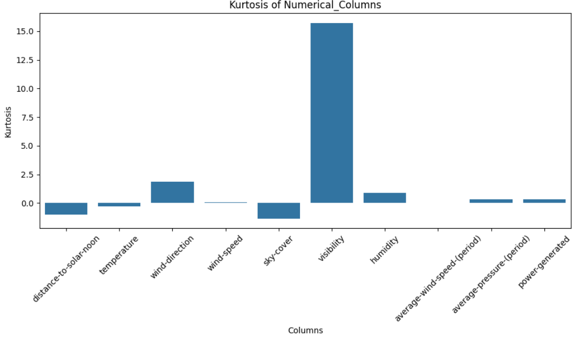
kurtosis

Slide 20
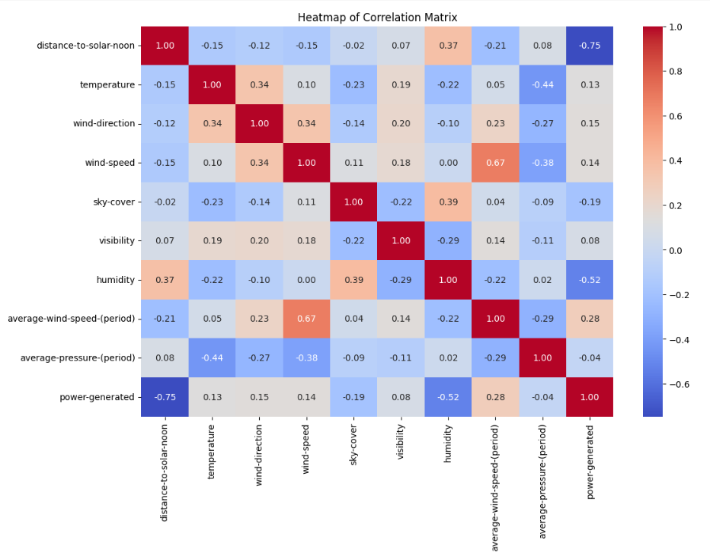
heatmap

Slide 21
Heatmap insights
Average-wind-speed-period has a high co-relation with the power generated.
Distance-to-solar-noon and humidity have a negative co-relation with the power generated.
Temperature, wind-direction and wind-speed have a positive co-relation with power generated but with a low value.

Slide 22
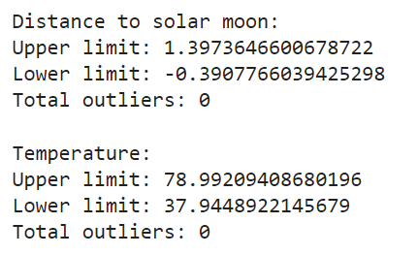
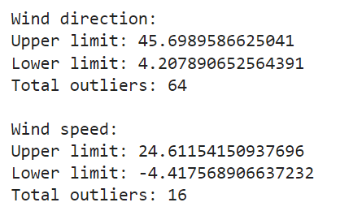



Outlier detection

Slide 23

scaling

Slide 24

Linear regression

Slide 25

lasso regression

Slide 26

ridge regression

Slide 27

Decision tree

Slide 28

Decision tree feature importance

Slide 29

Random forest

Slide 30

Random forest feature importance

Slide 31

ada boosting

Slide 32

ada boosting feature importance

Slide 33

xg boosting

Slide 34

xg boosting feature importance

Slide 35

svR

Slide 36

Model evaluation

Slide 37

Model performance

Slide 38
Evaluation Parameter matrix
Sr. No | Model Name | MSE | R2 SCORE | RMSE
1 | Linear Regression | 39581107.3747 | 0.6242 | 6291.3518
2 | Lasso Regression | 39576998.8548 | 0.6243 | 6291.0253
3 | Ridge Regression | 39586549.6718 | 0.6242 | 6291.7843
4 | Decision Tree | 18105747.7302 | 0.8281 | 4255.0849
5 | Random Forest | 11675993.6291 | 0.8892 | 3417.0153
6 | ADABoost | 15627491.3433 | 0.8516 | 3953.1622
7 | XGBoost | 10815889.5016 | 0.8973 | 3288.7520

Slide 39
Final insights and observations
Mean Squared Error (MSE) Comparison:
Linear Regression, Lasso Regression, and Ridge Regression have the highest MSE values, approximately 4 x 10⁷, which suggests they do not perform well on this dataset.
Decision Tree shows a significantly lower MSE than linear models, indicating better performance.
Random Forest has the lowest MSE, indicating it performs the best in terms of minimizing the error.
AdaBoost and XGBoost also show relatively low MSE, but XGBoost performs slightly better than AdaBoost.

Slide 40
Final insights and observations
R² Score Comparison:
Random Forest, AdaBoost, and XGBoost have the highest R² scores, all around 0.8 or above, meaning these models explain a high proportion of the variance in the target variable.
They are the most accurate models in this set.
Decision Tree follows with an R² score slightly lower than the ensemble methods, still showing decent performance.
Linear, Lasso, and Ridge Regressions show relatively low R² scores (~0.6), indicating that they explain less of the variance compared to decision trees and ensemble methods.

Slide 41
Final insights and observations
Root Mean Squared Error (RMSE) Comparison:
Like the MSE plot, Linear, Lasso, and Ridge Regressions show the highest RMSE values, indicating they have larger errors compared to other models.
Random Forest has the lowest RMSE, closely followed by XGBoost, which further confirms that these models perform better.
AdaBoost shows an intermediate RMSE, suggesting it's a strong model but not as robust as Random Forest or XGBoost.

Slide 42
Final insights and observations
Overall Observations:
Linear Models (Linear, Lasso, Ridge Regression) struggle with this dataset, showing poor performance across all metrics (high MSE, high RMSE, and low R²).
These models may be underfitting the data due to their simplicity.
Decision Tree performs better than linear models, but still lags behind ensemble methods in terms of overall accuracy.
Random Forest consistently outperforms all other models in terms of MSE, RMSE, and R², suggesting that it captures the data's complexity better.
XGBoost and AdaBoost are also strong contenders, with XGBoost slightly outperforming AdaBoost, especially in terms of MSE and RMSE.
Key Takeaway:
Random Forest and XGBoost are the best performing models for this solar energy dataset.
They should be prioritized when optimizing for both low error (MSE, RMSE) and high predictive power (R² score).
Linear models should likely be avoided for this specific dataset due to their consistently poor performance across all evaluation metrics.
Final conclusion:
XGBoost is the best performing model for this dataset

Slide 43

Deployment interface

Slide 44
Challenges and solutions
The dataset contained some null values which were handled using aggregate functions.
This was the first team task so proper communication and work distribution was a key factor in making the project a success.
Being a regression project, it had to be evaluated across a number of different algorithms and parameters. The dataset was trained and went through 7 different regression models and was judged based on 3 parameters Mean Square Error, R2 Score and Root Mean Square Error.
The final deployment was probably the toughest part where a web page had to be built for the user interface. It was achieved with the help of streamlit and pickle file.

Slide 45
THANK YOU!!!

